Slide 1

Don't Write Secure Code! a (Build secure systems instead)
@spetryjohnson
Notes:
Hello, and welcome to “Don’t Write Secure Code”. I’m Seth Petry-Johnson, and unlike some of the other speakers in this track, I am not a security professional. I’m just a normal programmer, although I do have a security related confession to make.

Slide 2
I hate writing secure code
Notes:
That confession is that I hate writing secure code.
NOT PROD of it, but when building a feature and elbow deep in complex business logic or functional requirements, I don’t want to think about security.
Want to be TOTALLY FOCUSED on biz problem, but ever-present security issues keep stealing focus.
User has to be logged in to do this. Have to have some permission to do that. Alice shouldn’t be able to see Bob’s data. … yadda
Constant need to pay attention to those same security concerns, over and over, feature after feature, bums me out.
So, maybe a better way of expressing myself is that

Slide 3
I hate writing secure code I hate writing secure feature code
Notes:
I hate writing secure feature code.
Actually don’t mind thinking about security, enjoy making system secure, just want to separate security code from features.
Want features to be clean / simple / elegant, not sullied up with a bunch of duplicate security checks copied and pasted between features.
So I guess what I’m really trying to say is that

Slide 4
I hate writing secure code I hate writing secure features I hate implementing cross-cutting security concerns by repeating the same patterns over and over again in my feature-level code
Notes:
Hate implementing cross-cutting security concerns by repeating the same patterns over and over again in my feature-level code.
That’s mouthful, but it’s exactly what this talk is all about. Because I hate doing this, I’ve invested time and energy looking for ways to avoid it.
Way I typically avoid it is by extracting security code into some part of my application framework so that it can be automatically applied across all features. This lets me keep brain in “feature mode”, keeps my feature code clean, and I still get to deliver secure system.
Over next 55 minutes going to share techniques with you. I want you to recognize intermingling of security & feature code in your systems, and give you tools for decoupling them so that you can maximize both security AND maintainability.

Slide 5
What's on the agenda?
Define "cross cutting" security concerns
Notes:
Here’s our agenda:
First I’ll define what it means for something to be a “cross cutting” security concern and what types of things are best suited to pushed into the framework.

Slide 6
What's on the agenda?
Define "cross cutting" security concerns
"Secure by default" examples
Notes:
Second, going to show you some examples of cross-cutting concerns that you can 100% completely solve in your framework code, without requiring any changes to your feature code.
Call this being “secure by default” b/c once these things are in place, it takes literally zero effort for developers to ship secure features.
If you're familiar with the phrase "pit of success", then that applies here because it actually takes more effort to be INSECURE than secure.

Slide 7
What's on the agenda?
Define "cross cutting" security concerns
"Secure by default" examples
Declarative vs Imperative security
Notes:
Unfortunately, not everything can be made fully secure by default, and sometimes you’ll still need to put some sort of security code into your features. I’ll show you how a declarative approach results in better factored code that minimizes the intermingling of concerns.

Slide 8
What's on the agenda?
Define "cross cutting" security concerns
"Secure by default" examples
Declarative vs Imperative security
Audit / Testing
Notes:
Finally, I’ll show you some ways that you can use static analysis tools to perform a security audit, and how you could incorporate that audit into your automated testing process.
Code samples in this talk are in .NET and JS, because that’s what I’m familiar with. However, many of the techniques I’ll show you have parallels in other languages and platforms as well, so the general ideas should be portable even if the specific code samples are not.
Also, before we go any farther, I tend to speak pretty fast, so if you need me to stop and elaborate on anything, please raise your hand. I put this line in the talk to remind myself to slow down, which I will try and do, but please – if you have any questions or comments please don't hesitate to let me know.

Slide 9
Application "framework"
Any code that leverages "hooks"
in the underlying system
Notes:
The main point of this talk is the idea of pulling cross cutting concerns out of your feature code and pushing them down into your framework.
Before I show any code, let me define those terms a little better.
When I talk about “framework level code”, referring to any code that leverages hooks in an underlying system or library so that it can be automatically executed at a specific time.

Slide 10
What framework stuff can I tap into?
MVC ActionFilter attributes (OnActionExecuting)
ASP.NET HTTP Modules
jQuery AJAX events (ajaxStart, ajaxEnd,etc)
ORM interceptors (connection opened)
Notes:
For example, ASPNET MVC lets you tap into the MVC pipeline w/ Action Filter.
ASP.Net HTTP MODULES let you tap into the entire ASPNET request pipeline
jQuery lets you tap into AJAX request pipeline using global event handlers.
ORMs like EF & NH let you run code whenever a database connection is opened or transaction begins.
And if you need hook that doesn’t already exist, tools like PostSharp let you create your own. We’ll talk about this in a bit.
And of course, your CUSTOM APPLICATION code might provide framework level hooks. For instance, if you have some base class that everything derives from, then you can provide your extension points that make sense in your own system.
Basically, when I say “framework code”, I’m referring to something that you write that gets EXECUTED AUTOMATICALLY by some underlying system, as opposed to the specific feature-level code you write at the top of your stack.

Slide 11
"Cross cutting" concern
Any security requirement that
spans multiple features
Notes:
When I say “cross cutting concern”, I’m referring to any security requirement that spans multiple features.
Cross cutting concerns can be low level & unrelated to your business domain, such as SQL injection.
Higher level requirements can be cross-cutting as well. You might have group of related pages or features that share permission requirement or access control strategy.
In both cases, the point is that separating cross-cutting concerns from feature or page-specific concerns makes code easier to maintain and your system more secure.
To illustrate this, I used my world-class Visio skills to bring you this example.

Slide 12

"Cross cutting" concerns
Security Requirements:
User must be logged in
Users only see their own Orders…
… unless they have "Manage Orders" permission, and can see everything
Notes:
This beautiful green square represents a feature on our website. It’s the “Order List” feature that displays to a user the list of orders that user is allowed to see.
Page has three requirements:
1) user must be logged in to see the page. 2) users can only see their own data, 3) Unless they have a specific permission that grants them access to all records

Slide 13
"Cross cutting" concerns
Security Requirements:
User must be logged in
Users with the "Manage Orders" permission see all Orders
Everyone else sees only their own Orders
Notes:
The naïve approach is to implement those requirements directly within the feature code.
This beautiful red square represents the security code being intermingled with the feature code.
If this was an MVC app, for instance, this red square might represent a couple of lines of code in the body of a controller action.

Slide 14
"Cross cutting" concerns
Notes:
The next feature we build is the Order Detail page so that the user can click on an Order and get more information about it. This page probably has the exact same security requirements for obvious reasons.
For the sake of this example, let’s assume those requirements are implemented exactly the same way on this feature as the first one.

Slide 15
"Cross cutting" concerns
Notes:
Next we build a feature to Cancel the order.
This feature should have same requirements as the first two, but maybe it was built by a different developer that wasn’t security conscious or was under some deadline pressure.
For whatever reason, this feature isn't secure at all.

Slide 16
"Cross cutting" concerns
Notes:
Finally, we build 4th feature to Refund the order. Again same requirements as other features, but maybe dev was unfamiliar with those implementations and they implement the same rules, but in a different manner. Maybe instead of doing check in controller action, they move into model or something. Red diamond represents the same basic rules, but implemented in a different way.
Problems with this approach might be obvious.
1 of these 4 features is insecure. If QA primarily tests through the UI, then as long as List & Detail page implement the rules, they might never discover that the Cancel feature allows anonymous access. With this architecture, only way to guarantee QA would find issue is via exhaustive, black-box testing of every rule against every endpoint
Maintaining the security code will be difficult. What happens when we add a new user role…

Slide 17
"Cross cutting" concerns
Notes:
If dev making the change doesn’t realize same rules are duplicated in other features, might end up changing just one of them. Now we have three implementations: triangle, square, and diamond.
Even if dev does replace all places using the “square” impl, might still miss Cancel feature w/ no security and Refund feature w/ “diamond” impl.
This is how security defects creep into software. Well-meaning developers either forget to implement a security check, or they inconsistently maintain security checks over time. Either way, we end up with a confusing and inconsistent mess of security code intermingled with feature code, or missing altogether.

Slide 18
"Cross cutting" concerns
Notes:
My approach would be to extract those business rules into something reusable so that we can implement the requirements only once.
There’s multiple ways that you could do this.

Slide 19
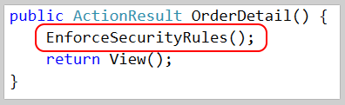
"Cross cutting" concerns
Notes:
The simplest would be to extract this logic into a helper method and call it from all 4 controller actions or something.
This would standardize on a single “square” implementation, but nothing prevents a developer from forgetting to call this method and leaving the feature insecure.
And again, the only way to guarantee that we'll find those insecure features, is if we're doing black-box testing of every single endpoint against the security requirements.

Slide 20
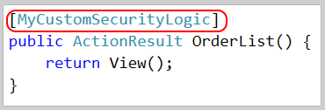
"Cross cutting" concerns
Notes:
Another approach would be to extract the logic into some sort of attribute that injects that logic into the appropriate part of the processing pipeline.
This also results in a consistent implementation, but it’s just as easy for a developer to forget. However, this approach is easier to audit. In a little bit I’ll talk about using static analysis to generate a report of secure and insecure endpoints based on attribute usage.

Slide 21

"Cross cutting" concerns
Notes:
In a perfect world, the developer wouldn’t have to do anything at all except write their business logic, and the security stuff would be handled automagically and in a way that was easily audited and tested. And that’s the point of this talk.
It isn’t always possible to get it quite this magical, but we can probably get a lot closer than you’d expect.

Slide 22
Show me the codez! bit.ly/DontWriteSecureCode
Notes:
For the rest of this talk I’ll be showing you a bunch of code samples from a demo app I wrote. This app, which you can get from my Github page, shows the same features implemented three ways: first, with no security at all, then using “secure feature” code where the security requirement is handled directly within the business logic, and finally with the security concerns extracted into some part of the framework.
I will move through my slides pretty quickly, but everything you’ll see up here comes straight from that project that you can reference later. It’s fully functional and heavily commented so I hope it’s a useful resource for you.
To start, I’m going to show you 3 examples of what I call a “secure by default” system. Each of these examples demonstrates how you can solve a problem once, and then more or less forget about it. Once it’s been solved in the framework, no additional developer effort is needed on a feature-by-feature basis.

Slide 23
Cross Site Request Forgery Fun fact*: users never log out. Ever.
* Not actually a fact.
Notes:
My first example deals with #8 on the OWASP Top 10, Cross Site Request Forgery. In case you’re not familiar with CSRF, here’s a quick overview.

Slide 24
Cross Site Request Forgery (CSRF)
Notes:
First, a user logs into a site they trust, such as their bank.
Second, while the session with the bank is active, they visit a malicious website. This could be in a different tab but it doesn’t have to be.
Third, the bad guy website tricks the user into submitting a form post TO the bank’s website, for example to the “transfer money” endpoint. If the bank website hasn’t been properly secured, all it’s going to see is a request coming in, from a logged in user with a valid session, requesting a fund transfer into the bad guy’s account.
In order to protect itself from this sort of thing, the bank needs a way to differentiate between a form post that initiated from its own domain versus a post that initiated from the bad guy’s website. The HTTP Referrer can help with this, but it’s insufficient on its own because that value is spoofable.

Slide 25
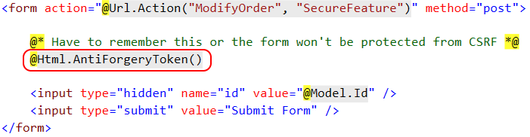
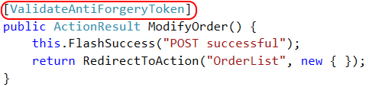
CSRF Defense – feature
Notes:
ASP.NET gives us tools to protect against CSRF. You have to do 2 things: call helper & add attr
The helper does three things. (1) creates a cryptographic token, (2) emits hidden form field, (3) creates cookie.
When form is submitted, the attribute compares the value in the form body against the cookie value and rejects the post if they don't match.
Browser’s security model prevents the bad guy website from reading or writing the cookies for the friendly site…
Easy to do, but not secure by default. Requires dev to make corresponding changes in two files. And if dev only does the first part…
Also, this only works if you’re submitting a form. This helper doesn’t really help if you’re doing an AJAX post because there’s no form to write the hidden field into.

Slide 26

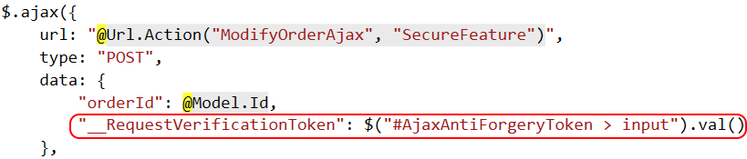
CSRF Defense – feature (ajax)
Notes:
If you’re making an AJAX form post, you have to do something like create a div, call the helper to create the hidden form field, and then manually copy that hidden form field value into your AJAX payload.
This really sucks. It’s ugly, it’s error prone, and it’s not a pattern that I want to be repeating every single time I need to make an AJAX post.

Slide 27
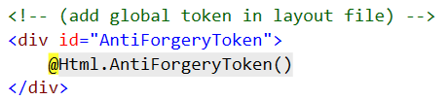
CSRF Defense – cross cutting
Notes:
To handle this in a cross-cutting way we need to do a few things.
First, we need to create one, global anti-CSRF token. I do this in my global layout file so that it applies to every page on my site. Remember that this creates a hidden text field AND creates a cookie.

Slide 28
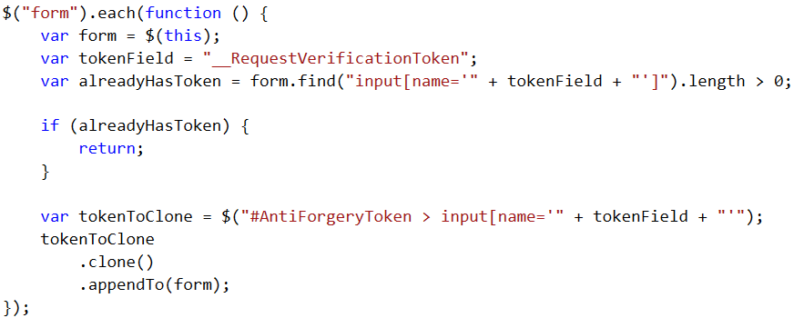
CSRF Defense – cross cutting
Notes:
Second, on document ready I run a tiny bit of jQuery that loops through every form on the page, looks to see if it already has a token field, and if not, clones the global one and adds it to the form.
This ensures that every single form that I use on my site will end up with a hidden field containing that security token.

Slide 29
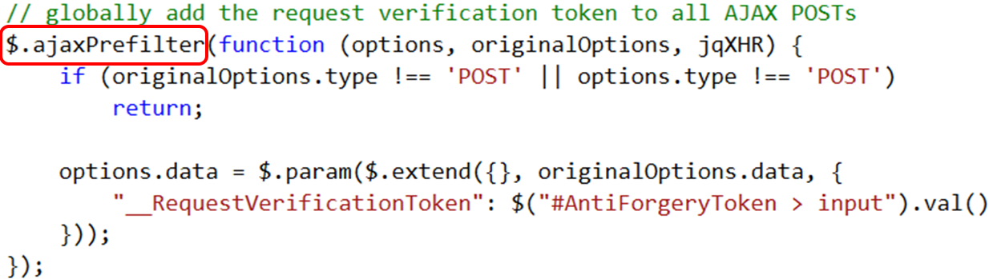
CSRF Defense – cross cutting
Notes:
To handle AJAX posts, I run a second bit of JQuery that defines a global jquery “ajax prefilter” handler.
Hooking into the prefilter event lets you can modify the AJAX options before the request is sent. In this case, I add that CSRF token to every single AJAX POST.

Slide 30
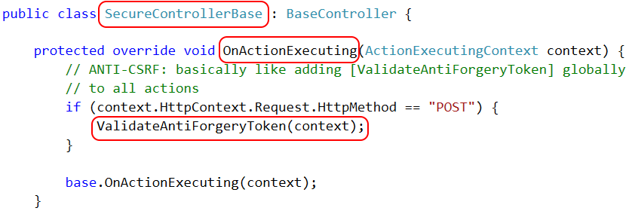
CSRF Defense – cross cutting
Notes:
Finally, we need to run the token validation logic automatically for all form post actions. We can do that by creating a custom controller class and overriding the OnActionExecuting method. The code that we put here will run on every single request, so if that request is a form post then we run the token verification logic.
The only thing the developer has to do is derive their controller from the correct base class. As long as they do that, everything is handled automatically.
And in fact, you could also implement this as an HTTP Module and then the developer wouldn't have to do anything at all. We'll talk about modules in a minute.

Slide 31

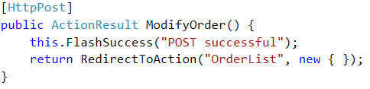
CSRF Defense – cross cutting
Notes:
Here’s what the feature level code looks like when we’re done. This is 100% business logic, and yet every single form post is still protected from cross site request forgery attacks.

Slide 32
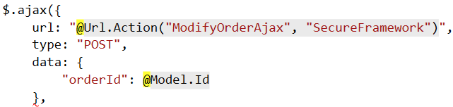
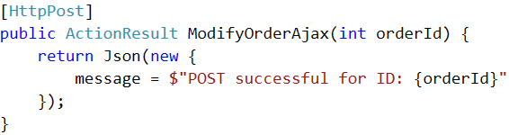
CSRF Defense – cross cutting (ajax)
Notes:
And here’s what it looks like for an AJAX POST. Again, it’s 100% business logic, yet still protected.
CSRF defense is a great example of a cross-cutting concern because it’s orthogonal to individual feature requirements, it applies globally to the whole system, and it’s pretty easy to make it “secure by default”.

Slide 33
Authentication Keeping out the unwashed masses
Notes:
My next example of making a feature “secure by default” deals with Authentication, or specifically with preventing anonymous access to protected areas of your site.
Most web frameworks make this fairly easy to do.

Slide 34
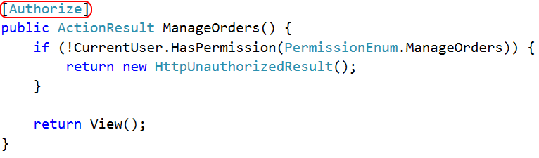
Authentication
Notes:
In ASPNET MVC, for instance, you can add the [Authorize] attribute to an Action and it will automatically redirect users to the login page if they aren’t logged in.
I don’t like using this though, because it represents a “public by default” model where any given MVC endpoint is accessible anonymously unless it is explicitly flagged as private. I tend to work on applications where the vast majority of resources are private, and only a specific few are public, so I want a “private by default” model instead.
One way to build a “private by default” model is to create a custom HTTP Module that runs on every request and enforces a login, unless the URL matches a whitelist of endpoints that allow anonymous access.
This is actually really easy to do.

Slide 35
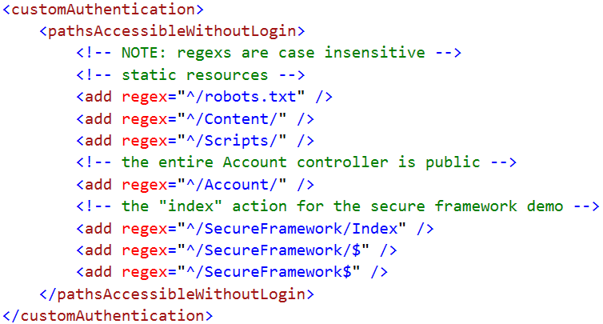
Authentication
Notes:
First, we need some place to manage that whitelist. Since our goal is to require zero changes to the feature code, I like to use a custom section of web.config to do this. That way I don’t need to make any changes at all to the controllers themselves.
Now, it’s important to note that HTTP Modules run for EVERY request, not just ones that get routed into MVC. That means that our whitelist needs to include static resources, such as stylesheets or scripts, that we want to use on our login page.
For that reason, I like to build my whitelist using regular expressions. That way I can create a single rule that grants access to my entire Scripts folder so that I don’t have to continually modify web.config each time we add a new jquery plugin.
Creating custom web config sections is really simple and you can find the code for this in my demo app.

Slide 36
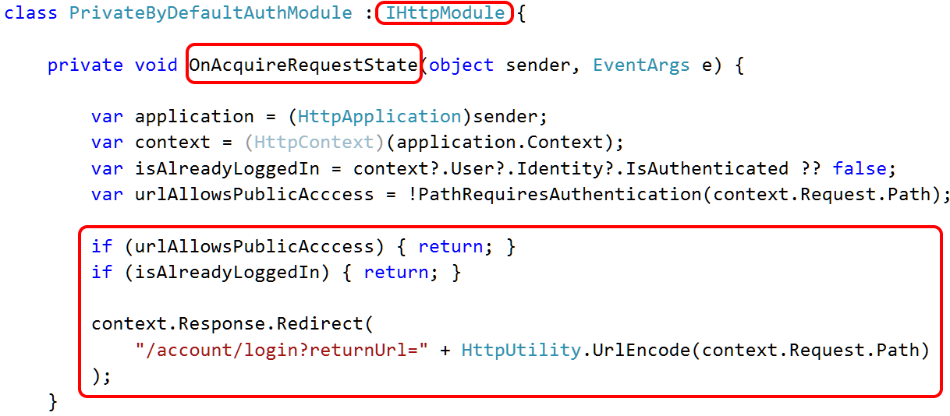
Authentication
Notes:
Once we’ve defined the whitelist, we need to create the HTTP module to enforce it.
This is also really easy to do. It’s just a class that implements the IHttpModule interface and then provides an implementation for this OnAcquireRequestState method.
In the body of this method we look to see whether or not the URL matches our whitelist and whether or not the user is already logged in. If either of those things are true then we do nothing. Otherwise, we send the user to the login page.

Slide 37
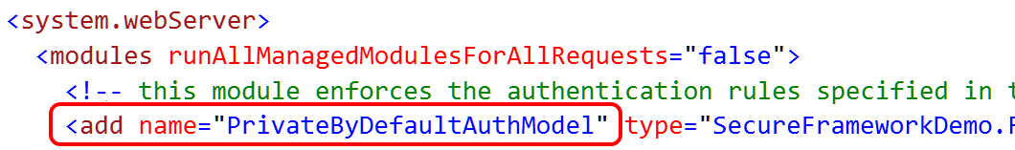
Authentication
Notes:
The last piece of the puzzle is to tell IIS to run that module for all requests, and we can do that with a single line of code in web.config.
And that’s it. Any request for any URL not on that whitelist will now require a login.
The developers literally need to take zero additional effort to make their endpoints secure, and if they want to make something public it’s just a single adjustment to the whitelist.
Also, in the last segment of this talk, I’ll show you a way to generate a report of all of your MVC controller actions and whether or not they are publicly accessible. That sort of auditing is a useful way of validating that your whitelist is doing what you expect it do.

Slide 38
Base classes vs HTTP Modules
Base Controller class
Super easy
Requires devs to inherit their controllers from it
HTTP Modules
A little extra effort / impacts non-MVC requests
Requires zero changes to feature code
Notes:
Before I go any father, I want to stop and review the two things we just looked at.
I used a base class to handle CSRF defense, which is really easy to do but requires programmers to derive from it to gain its protection.
For authentication, I used an HTTP Module that was fully secure by default because it required NO changes to any controller classes, but it was more complex to implement and I had to deal with non-MVC requests.
These are choices that you can make for yourself. You could handle CSRF with a module and be super secure, and you could simplify your authentication approach by just using a base class and requiring programmers to use it.
If you already have a common base controller in your system, then you might be able to use OnActionExecuting for all of this stuff and not deal with modules at all. It's up to you.

Slide 39
Access Control Keeping Bob's hands off Alice's data
Notes:
My final example of “secure by default” framework deals w/ access control, which is about preventing users from accessing data they don’t own.
This type of requirement tends to cut across multiple features. For instance, if there’s some code that prevents Bob from seeing Alice’s orders on a list page, then we probably want to apply that same restriction on the order details page. This makes it a good candidate for a cross-cutting concern.

Slide 40
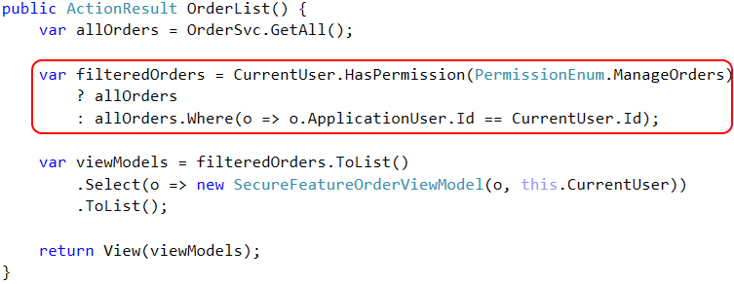
Access Control – feature
Notes:
This is what the Order List page would look like if access control code were intermingled with feature level code.
I call the data access layer for a LIST OF ALL ORDERS, and then I explicitly remove ones the user can’t access.
Again, this is an example of security logic being intermingled with feature logic.

Slide 41
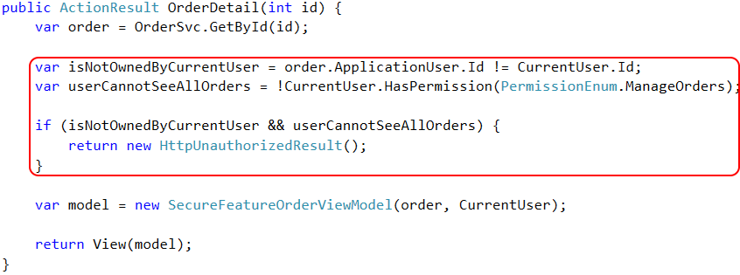
Access Control – feature
Notes:
On the detail page, that same requirement looks like this.
First I call GetById to retrieve a SINGLE order, then I check the permission and fail the entire request if necessary.
This is an example of the same LOGICAL RULE being implemented in two different ways. One of these is a red square, and the other is a red diamond.
Without a centralized impl it’s going to be very difficult to keep them in sync as requirements change.
There are two ways that we could centralize the implementation of this access control logic.

Slide 42
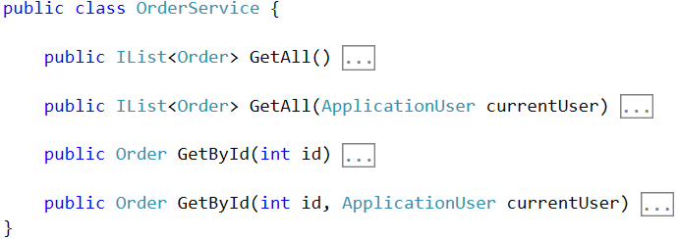
Access Control – framework
Notes:
The easiest way to handle this cross-cutting concern is to push the access control logic into the data access layer where it can be reused by multiple features.
Example of simple data service that provides two ways to get order data. GetAll / GetById
Two versions of each method – one that takes the current user as an argument, and one that doesn’t. The one that does provides access control
Why have two versions? Well, there might be scenarios where there is no “current user”, such as an automated maintenance program running on a schedule.

Slide 43
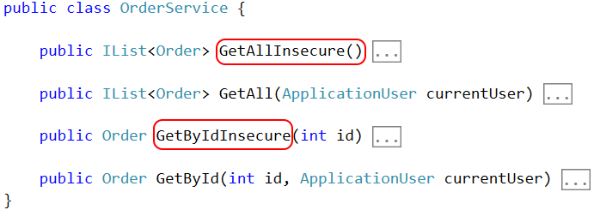
Access Control – framework
Notes:
If you can avoid it, I recommend NOT having the insecure versions at all. But if you do have to provide two versions of your data access methods, I recommend a naming convention that reminds developers of their obligations.
For instance, if I type “OrderService.GetById”, nothing tells me whether or or not access control is being handled.
But if I type “GetByIdInsecure”, that’s a pretty clear reminder that I’m on the hook for security in my feature code.
This approach is better than nothing, and it does push the access control logic down from the top level feature code and into the data access layer. But this is NOT SECURE BY DEFAULT; the security code needs to be manually added to every data access method, and that can result in a lot of duplication. It can also result in a lot of inconsistency if each method implements those rules in a haphazard way.

Slide 44
Access Control – Row Level Security
Notes:
Another way to handle access control is through a technique called Row Level Security. The idea here is that instead of filtering out data in our application code, we create a security policy in the database itself that does the filtering. Then, the application can simply ask for the data it needs, and the database will only return the data that the user is allowed to access. This essentially makes the access control transparent to the application code and makes the entire data access layer “secure by default”.
Of course, the devil is in the details, and this approach depends heavily on making this security policy thing aware of who the current user is. Unless you want to give each of your users a dedicated database login, this is typically easier said than done.
However, SQL Server 2016 added a new feature that makes this much, much easier to do.

Slide 45
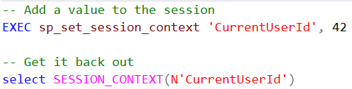

Access Control – Row Level Security
Notes:
This new feature is called the “session context”, and it’s basically a key/value collection that’s scoped to the database connection. This gives us a global dictionary that is shared by all queries within a connection.
You put a value into the collection like this, and you can select it back out like this. And you can read this value anywhere in the connection: inside a view, inside a stored procedure, etc.
This now gives us a really easy way to tell that security policy who the current user is. Here’s how it all works.

Slide 46
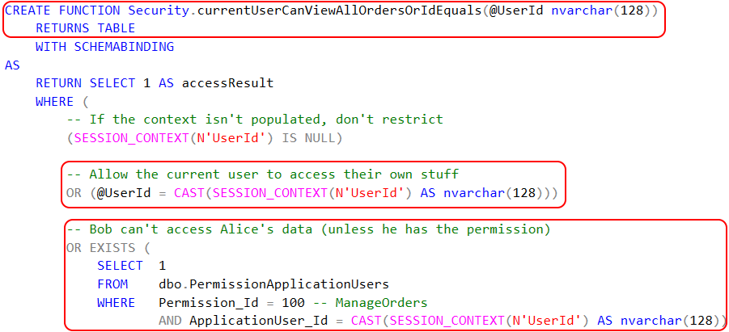
Access Control – Row Level Security
Notes:
First, we need to create predicate function. This function will get executed against EACH ROW of a result set containing Order records and controls which of them get returned to the application. It's LIKE A LAMBDA that you might pass to a LINQ query to filter a result set.
The function assumes that the current user ID has been added to the session context. It accepts as input the user ID associated with an Order.
If the user ID that’s passed in is equal to the value in the session context, user is viewing own order. If the ID that’s passed in is NOT EQUAL then we do a perm check.
There is one gotcha here: when we’re done, the security policy is going to execute this predicate whenever ANYONE tries to access the Orders table. It’s important that you check to see if the user ID is in the session context or not. If not, don’t filter anything. Otherwise, you won’t be able to see the data in SSMS without setting a user id.
Once we have this predicate defined, we need to tell SQL Server where to use it.

Slide 47

Access Control – Row Level Security
Notes:
To do that, we create a security policy on the Orders table that contains a FILTER PREDICATE referencing the function we just created.
Once this is in place, any attempt to read from the Orders table will be subject to the access control logic we defined.
The last piece of the puzzle is to actually set the user ID into the session context so that it’s available to the security policy.
To do that, we need some sort of hook that we can tap into and run custom code at the start of every database connection.

Slide 48
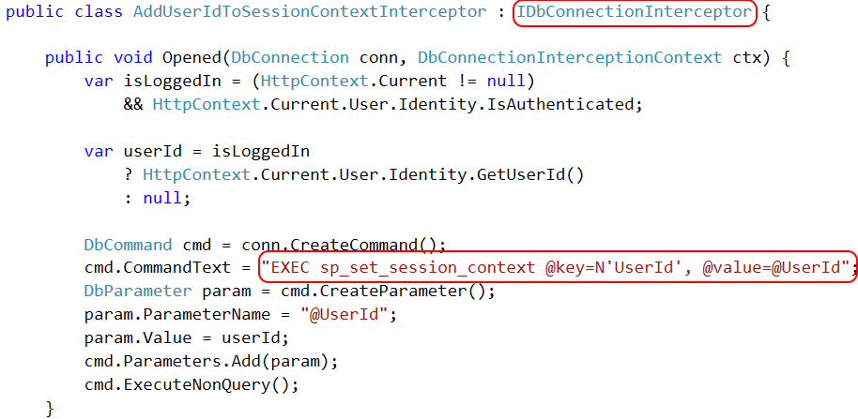
Access Control – Row Level Security
Notes:
In Entity Framework, for example, we can create a class that implements the IDbConnectionInterceptor interface and implement the “Opened” method. The code we put here gets run each time Entity Framework opens a new connection.
All we need to do is figure out who the current user is, and then add that value to the session context.
That’s it.

Slide 49
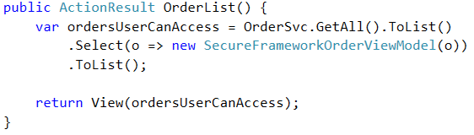
Access Control – framework
Notes:
Once those things are in place, our feature code can be 100% focused on business logic because all of the access control is taking place automatically. Pretty sweet!
SESSION_CONTEXT is a brand new feature in SQL Server 2016. If you’re running an older version of SQL Server you can do something similar, it’s just not as nice.

Slide 50
Access Control – framework
SQL Server 2012/2014 | SQL Server 2016
CONTEXT_INFO | SESSION_CONTEXT
Single binary value | Key-value pairs. Values are SQL_VARIANT
Max 128 bytes | Max 256 kilobytes
Can't prevent DB users from modifying | Keys can be made readonly
Minor behavior differences in Azure SQL | Identical behavior in 2016 / Azure SQL
Notes:
Earlier versions have a similar feature called CONTEXT_INFO that let you associate data with the connection itself. However, it only lets you store a single binary value with a maximum of 128 bytes. That’s not a lot of data, so at best you can store a tenant or user ID, and you also have to deal with conversions to and from binary.
SESSION_CONTEXT gives you multiple key-value pairs with more storage space and you get a slightly nicer data type of SQL_VARIANT. It’s certainly possible to do row-level security in older versions, it’s just nowhere near as pleasant.

Slide 51
Page-level Authorization Keeping Bob in his sandbox
Notes:
I just showed you three things that you can implement completely in your framework, with no feature level code whatsoever.
In many cases, though, the security concerns can’t be fully swept under the covers. Authorization is a good example of why. You can move the code that implements a permission check into the framework, but you still need something at the feature level to indicate which permissions are required.
These next examples are going to show you how to take a declarative approach to those concerns so that you can decouple the implementation of the security check from the declaration that it’s actually needed.
Let’s start with a basic example where we want to ensure that only users with a specific permission are allowed to access a certain MVC endpoint.

Slide 52
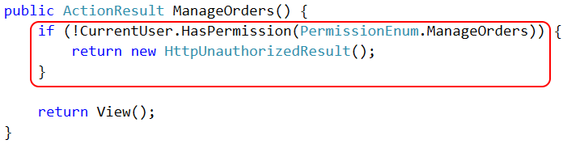
Page Authorization – feature
Notes:
If you implement this rule in feature code it will look something like this: somewhere in the body of each page or action you’ll check to see if the user has the necessary permission and, if not, you’ll kick them out.
This is simple, but it results in a lot of duplicative code. If you change how the permission check works, or if you decide you want to do something different than return an HttpUnauthorizedResult, you’re going to have a lot of places to modify.

Slide 53
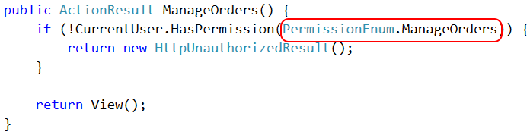
Page Authorization – feature
Notes:
The only thing about this piece of code that will change between features is the specific permission that is required; the rest of this code is boilerplate, and that makes it a good candidate for being solved in the framework.

Slide 54

Page Authorization – cross cutting
Notes:
To make this a cross-cutting concern, extract the implementation of the permission check into an Action Filter attribute, and then provide the feature-specific data as an argument to that attribute.

Slide 55
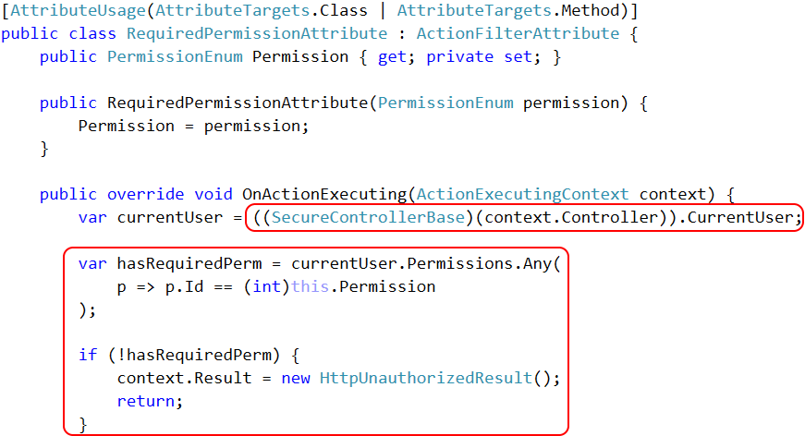
Notes:
The implementation is really straightforward. MVC will automatically execute the code at the right time, so the only tricky thing is figuring out what permissions the user has. If your controllers all derive from that base class I keep talking about, then just add a “CurrentUser” property to that base controller and then you can access it with a little bit of casting.
Once we know who the user is, we can enforce the permission check from a centralized place.

Slide 56
API Authorization Cool kids create web APIs, not web pages
Notes:
That covers authorization of MVC endpoints. You can do the same thing with your API calls.
Since APIs generally don’t maintain state, each request has to carry with it whatever data is necessary to handle authentication and authorization. One simple way is to use what’s called “bearer tokens”. A bearer token is some secret value, like a password, that’s passed to the API with every request. This is typically provided as a header, but it doesn’t have to be. It can also be provided as a querystring or form argument.
In my system we use a thing called an API Key. An API key uniquely identifies a user of our system, and each key is associated with one or more permissions stating what it’s allowed to do.
So when an API request comes in, that value tells us both WHO is making the call and what they are allowed to do.

Slide 57
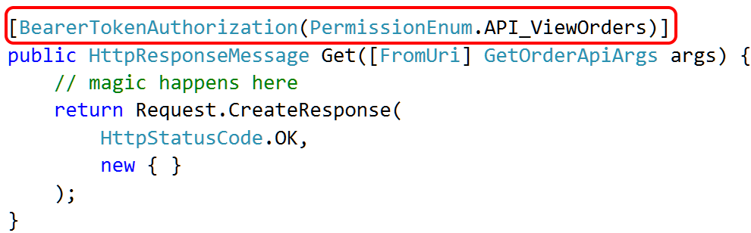
API Authorization
Notes:
The same techniques we used for MVC authorization work for WebAPI as well.
We just decorate the API endpoint with an attribute stating which permissions are required, and then handle the authorization in a centralized place.

Slide 58
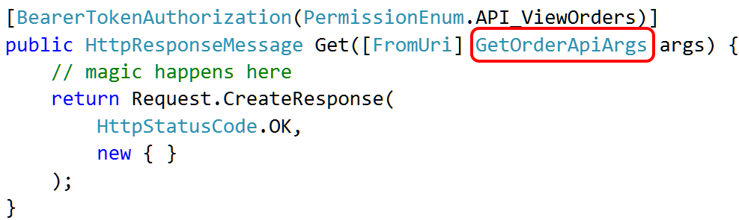
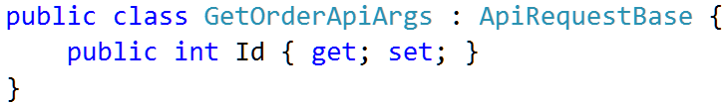
API Authorization
Notes:
The difference is that, using this custom API key approach, that attribute needs to handle both authentication AND authorization. The way we do that is to ensure that every API argument class derives from a base class called ApiRequestBase. This base class defines the API key properties that we use for authorization and provides the mechanism for extracting those values from the header or querystring or whatever.
Once we have these things in place, we can both verify that an API key is valid AND that it has the necessary permissions to perform the given API request entirely in framework code. The only thing that appears in feature code is the declaration of which permission is needed.

Slide 59
Property-level Authorization Down the rabbit hole with PostSharp
Notes:
In some cases, you might need to apply permission checks at a more granular level than you get with page-level authorization. For instance, certain parts of a page might be hidden or locked based on the user’s permissions, or specific pieces of data might be hidden for certain types of users.
With a little extra effort, you can handle these requirements with framework level code as well.

Slide 60
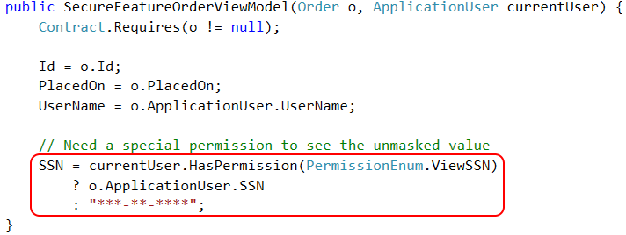
Property Authorization – feature
Notes:
This is a feature-level code sample from a view model in my sample app. It implements a business rule that a user must have a specific permission in order to see plain-text social security numbers. If the user doesn’t have the permission, the value gets masked for display.
Just like with page-level authorization, this is simple to do in the feature code, but it can result in a lot of duplication. It also requires that we couple the object model to the concept of a user identity, which might be undesirable.
And since this rule applies to any feature that displays SSNs, it meets our definition of a cross cutting concern that should be extracted from feature level code.

Slide 61
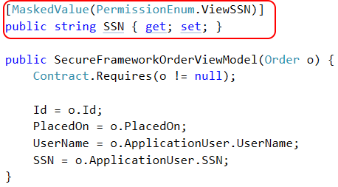
Property Authorization – cross cutting
Notes:
This is what we’d like to do: just put an attribute on the property, declare permission, & be done.
If this worked, it would be awesome. NO REF TO APP USER, which is a cleaner design, & would be easy to use this approach on other properties w/out duplication
Unfortunately, easier said than done. MVC provides a framework that we can tap into, but .NET doesn’t. There’s no way to automatically run this code whenever someone tries to read the SSN property.
Fortunately, we can use a really neat tool called PostSharp to create those hooks. PS is an AOP tool specifically designed to handle cross cutting concerns. It works by modifying the IL that is produced by the C# compiler in order to do things that aren’t natively supported in the language.

Slide 62
Property Authorization – cross cutting
Notes:
Here’s an example. This is a standard C# property. Behind the scenes, the C# compiler creates a getter method that returns some instance variable, and any code that reads this property is essentially calling this method. The property syntax is just a syntactic sugar over this getter method.

Slide 63
Property Authorization – cross cutting
Notes:
Using PostSharp, I can create what’s called a “property interception aspect”. This is basically a piece of code that we want to “inject into” the property.
When I compile the project, the PostSharp engine basically re-writes the getter method, injecting the code from the aspect into it.
Now, any code that is reading that SSN property is actually calling a method that now includes the security code.

Slide 64
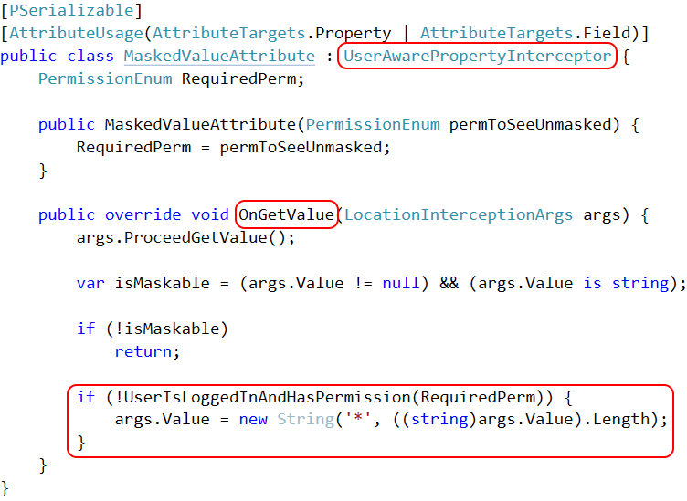
Notes:
This is what that interception aspect actually looks like.
First, I created a base class called a “UserAwarePropertyInterceptor”. That class is responsible for talking to the current thread and figuring out who the current user is. This is what allows us to decouple the view model itself from the application user class.
PostSharp gives us this OnGetValue method to override. This method basically provides the code that will get injected into that property getter method. This is where I put the permission check and, if the user doesn’t have the necessary privileges, I return a masked value instead of the raw SSN.

Slide 65
Property Authorization – cross cutting
Notes:
And as a result of that PostSharp magic, I’m able to do exactly what I want to do. All I need to do is put this “MaskedValue” attribute on a view model property, and the raw value of that property will be automatically hidden if the user lacks the correct permissions.

Slide 66
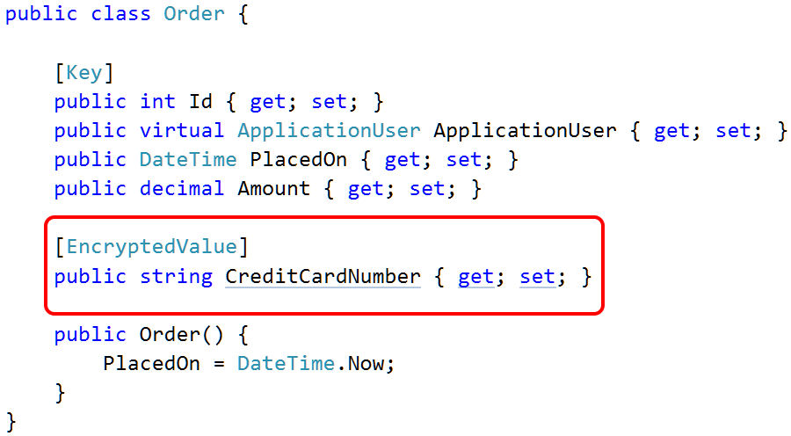
Other uses for PostSharp
Notes:
PostSharp has tons of other uses as well. Basically, it is purpose built to help you globally implement cross-cutting concerns, which makes it useful not only for security but for general application coding tasks as well.
Instead of just masking values, we could implement an encryption scheme as well. The interception aspect could encrypt a value when it’s being stored and decrypt it when it’s being read.
There's a sample implementation of this EncryptedValue attribute in my demo code, and the comments in that code point to a github repo by somebody else that implements a much more robust implementation that deals with key storage and a bunch of other real-world encryption concerns.

Slide 67
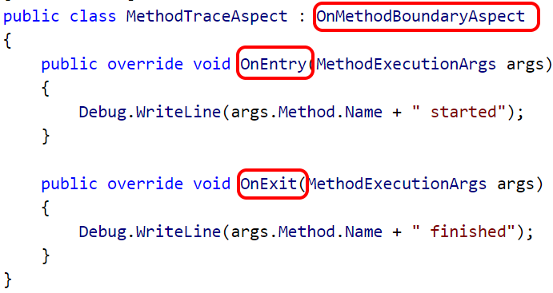
Other uses for PostSharp
Notes:
PostSharp can also intercept method calls, not just property access.
This screenshot is taken from the PostSharp website, which has some great tutorials, and it shows a "method boundary" aspect that can inject code just before or just after a method has been executed.
You could apply this aspect to specific methods, or you could apply this at the class level and it will automatically apply to all methods in that class.
This could be used for logging, or caching, or for additional types of authentication or access control. If you've ever wished "man, I wish I could just automatically do <x> whenever <y> happens", then you really need to check out PostSharp.
PostSharp is available on Nuget, but it is a paid tool. There's a free version if your project is small enough, but given the number of things it can do, the cost is very reasonable.

Slide 68
Auditing and Testing Try this with your fancy dynamic language!
Notes:
For the final segment of this session I want to talk about auditing and testing.
Building a secure system is about more than just writing secure code. It’s also about the overall development process and how effectively it helps your team spot and remove vulnerabilities that might otherwise sneak past the developer.
In my experience, exhaustively testing the security of an application is a moving target. You can spend an obscene amount of time and energy doing a full system test, and then your confidence in the results vanishes with the first non-trivial commit that gets pushed. Every time a dev changes existing code there’s the risk that they inadvertently broke an existing security check, or inadvertently introduced a new vulnerability.
One way to mitigate that risk is to automate as much of the security audit and testing as possible, so that you can continually re-run it as the code changes. And in very general terms, this will be easier to do when you’ve isolated your security code into cross cutting concerns.

Slide 69
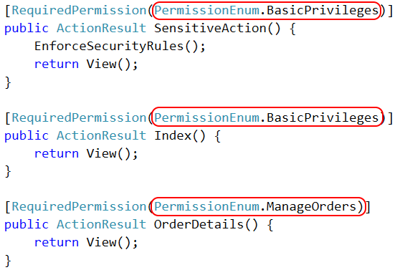
Authorization auditing
Notes:
Here’s an example:
Let’s say we have a large website with lots of endpoints, each requiring diff perms. It’s reasonable to expect QA team to verify that every endpoint implements the correct checks.
Brute force approach would be for QA to perform BLACK BOX TESTING against every single endpoint. This is expensive. Even if they fully automate browser tests it's still expensive and brittle.
Another approach would be for dev to write unit tests for controller actions, but if that’s all we do then QA has no opportunity to double-check dev's work. Testing is less expensive, but at cost of SINGLE PT OF FAIL.
In the best of both worlds QA would be involved, but they’d have a more efficient way of doing so than black box testing. And, if you’ve implemented your security code as cross-cutting concerns, then you have some interesting options available to you.

Slide 70
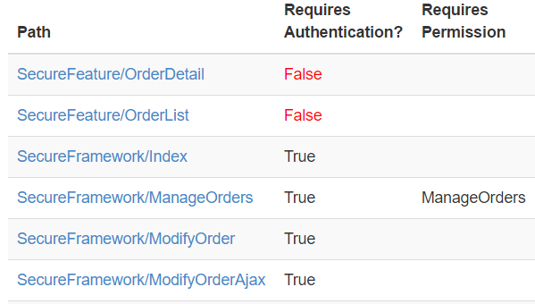
Authorization auditing
Notes:
For instance, if you’ve implemented your authorization checks using attributes, then it’s really easy to write a little bit of reflection code to generate a report like this.
This report shows a list of endpoints, whether or not they require a login, and any specific permissions they require.
If you publish this report to your QA team, they can be responsible for cross-referencing this data against their security matrix or requirements documents or whatever, so they can maximize the time they spend looking for mistakes and minimize the time they spend fighting with tooling or automating the browser.

Slide 71
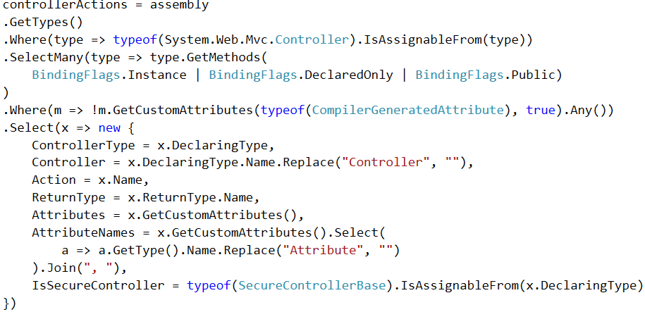
Authorization auditing
Notes:
That report was really easy to create. This is basically all it took.
Using reflection, I look for every class that is a type of MVC Controller, I identify all of the public instance methods that are available as endpoints, I ignore some behind-the-scenes stuff added by the MVC framework itself, and then I return an anonymous data structure summarizing those methods.

Slide 72
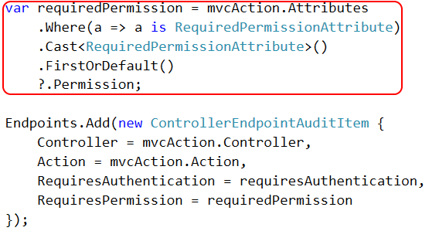
Authorization auditing
Notes:
After that, all it takes is a short loop over the data structure to generate the report. Since both the authentication and authorization data are expressed as attributes, it’s easy to use reflection to determine which endpoints require a login or a permission.
If I had implemented those checks as plain-old feature code, rather than using attributes, this would have been a lot harder to do. Granted, with the introduction of Roslyn it’s now possible to do static analysis of method bodies themselves so you could do something like this without attributes, but it’s certainly easier to use reflection and look for the presence of attributes.

Slide 73
Authorization auditing
Notes:
In my example here, I’m showing a report of MVC endpoints and the permissions they require. But it would be just as easy to generate a report showing which properties of which classes are using the MaskedValue or EncryptedValue attributes, or whatever else that you’ve implemented as a cross-cutting concern using Attributes.
However, let’s say you have a large application and these reports contain hundreds or even thousands of rows. We’ve made QA’s job easier than the alternative, but it’s still far from “easy”. They still need to examine the report, compare it against their “source of truth”, and identify anything that’s been added, removed, or changed.

Slide 74

http://approvaltests.com
Notes:
The very last thing I’m going to show you today is using a library called ApprovalTests to automate the auditing of this report.
Approval Tests is an alternative way of writing assertions in your tests. It works with everything from MSTest to NUnit to RSpec to Cucumber and a bunch of things in the middle. It is freely available on Nuget.
It’s designed for scenarios where you have an automated test that does some work, but where you need a human being to interpret the results. That’s exactly the scenario we’re talking about with this security audit idea: we can run some code to produce a report showing our endpoints, but we specifically WANT a human being to verify it.
Here’s how you could use this for your security audit.

Slide 75
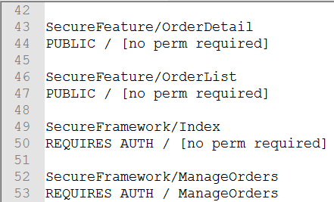
Approval Tests – Step 1
Notes:
First, create a plain-text version of the report that you want to audit. In my demo project I wrote a simple console app that produces a report like this. It’s the same data I just showed you in that HTML page, but in plain text.

Slide 76
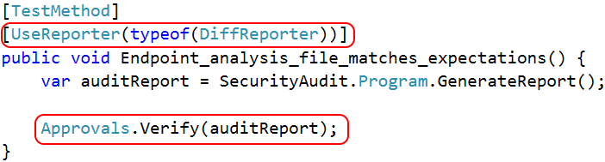
Approval Tests – Step 2
Notes:
Next, write a unit test that generates that report. Instead of making an assertion, however, call Approvals.Verify() and pass the report text. You can also work with files on disk if you have to, but keeping it string based makes things a little easier.
The Approval Test framework keeps track of the “accepted” state of each test. When this test runs, the framework will compare the new version of the report text against that last known accepted state. If they match, the test passes. If they don’t match, Approval Tests automatically opens a diff tool so that a human being can compare the results and make a decision.

Slide 77
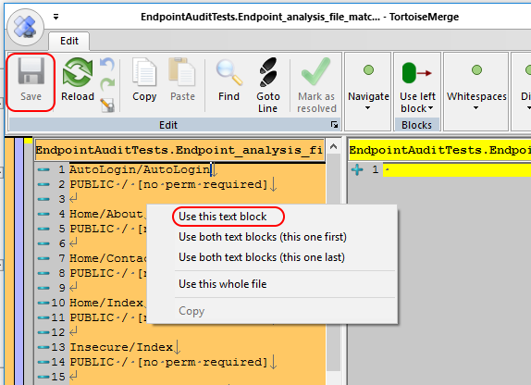
Approval Tests – Step 3
Notes:
The very first time that QA runs the test, since there is no “accepted state” yet, the test will launch a diff tool, like you see here. On the left is the report text, and on the right is a blank file.
At this point, the tester would manually verify the report contents. Once they are satisfied that everything matches expectations, they’d merge the left contents into the right file and save them. This is what creates the “accepted state”.
From this point forward, as long as the output of the report doesn’t change, the test will pass without manual intervention.

Slide 78
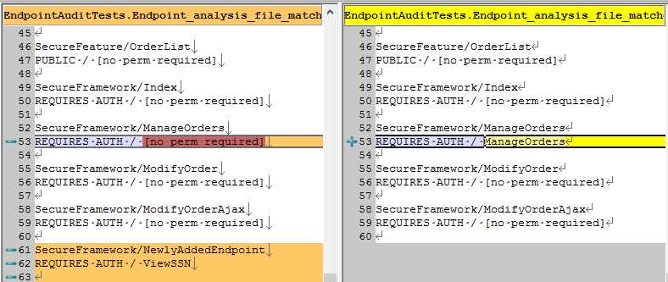
Approval Tests – Step 4
Notes:
In the future, let’s say I make two changes. I add a new endpoint, and I accidently remove the permission attribute from an existing endpoint.
The next time that QA runs the approval tests, the diff tool will automatically open and will show the differences. In this case, the tester might determine that the new endpoint was expected and is configured properly, but the removal of the permission setting for the existing endpoint was not expected. The tester could then open a security ticket or otherwise contact the developer to discuss.
This is all really simple to set up, if you’ve written your security code in a way that lends itself to static analysis.

Slide 79
What makes auditing easier?
Using [Attributes] to decorate classes/methods
Inheriting a base class
Implementing an interface
Notes:
Generally speaking, these are the things that are easiest to audit using reflection: attributes, class inheritance, and interface implementation. If you use these techniques to implement your cross cutting concerns, then you’ll find it pretty easy to do security audits with a little bit of custom code.
If you don’t do this, for instance if you implement your security concerns as just some random methods that get called from specific places in your code, then it’s going to be harder to audit.

Slide 80
Recap The CliffsNotes version
Notes:
Let’s do a quick recap.
WHOLE POINT is to extract security code from feature code and push it into framework where it can be executed automatically.
MVC action filters / HTTP Modules / jQuery AJAX events
Custom Base classes / ORM interceptors / database security policies / etc
Remember that if C# or MVC or your custom application framework don’t provide hooks that you need, you can use PostSharp to create your own. It’s specifically designed to handle cross cutting concerns.
The holy grail of course is to make features “secure by default” by completely handling the security need in a global way. If you can't completely do that, at least separate the implementation of the check from the declaration that the check is needed
Lastly, you can audit your system by using reflection to generate reports showing which features use which security measures. And for bonus points, use the Approval Tests framework to minimize the effort it takes to manage those reports.

Slide 81
bit.ly/DontWriteSecureCode
Global CSRF defense
Private-by-default MVC controllers
Row level security in SQL Server 2016
Permission-based MVC attributes
Permission-based property access, with PostSharp
Auditing w/ reflection and Approval Tests
github.com/spetryjohnson | www.petry-johnson.com
@spetryjohnson
Notes:
My examples of those concepts are in my sample app, which you can get from this link here.
This github repo contains my slide deck, my speaker notes, and a fully functional sample of everything I showed you today. You should be able to check it out, run the EF migration, and launch the app. There's on-screen text to walk you through using it.
You can get ahold of me through GitHub, my blog, or on Twitter. I’d love to hear from you, and feel free to send a pull request if you add a technique of your own.
Thank you so much!

